Slide 1

Title: Smart Attendance Management System
Course: C++ Programming(Semester II)
University: ITM Skills University
Developed By: Akshara Tanted
Objective: To automate the process of recording, managing, and analyzing student
attendance efficiently using a digital system.

Slide 2

Problem Statement
In many educational institutions, attendance is still recorded manually. This process is time-consuming, prone to human errors, and difficult to manage when the number of students increases. Teachers often face challenges in maintaining records, calculating attendance percentages, and identifying students with low attendance.
Manual attendance tracking can cause several problems:
a. Time-consuming for teachers
b. Errors in attendance calculation
c. Difficulty identifying students with low attendance
Therefore, Educational institutions need an efficient way to manage student attendance
Goal:
Develop a C++ program that records attendance and generates attendance reports automatically.

Slide 3
Proposed Solution
Smart Attendance Management System
The system performs the following tasks:
Stores student information
Stores course details
Records daily attendance
Calculates attendance percentage
Identifies students with low attendance
Generates attendance reports
Key Features:
Student Registration
Course Management
Attendance Recording
Attendance Analytics

Slide 4
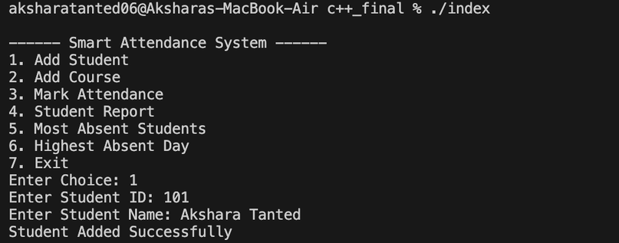
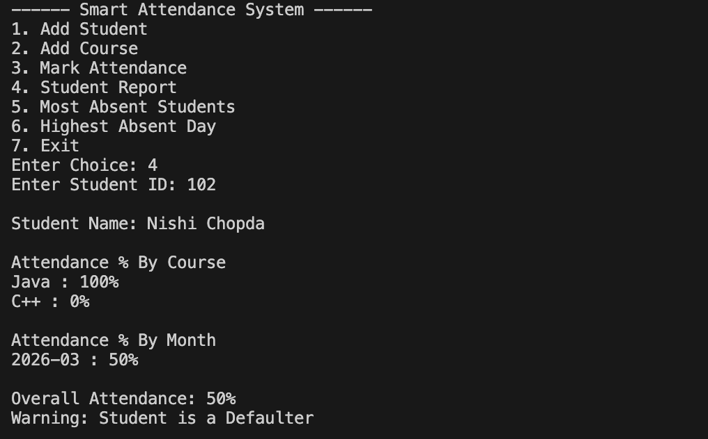
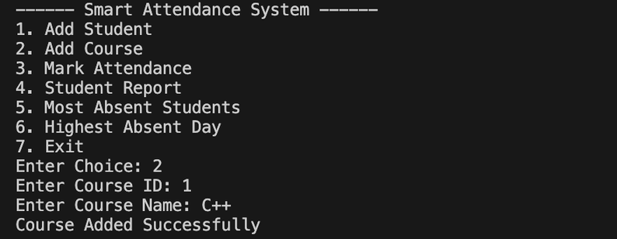
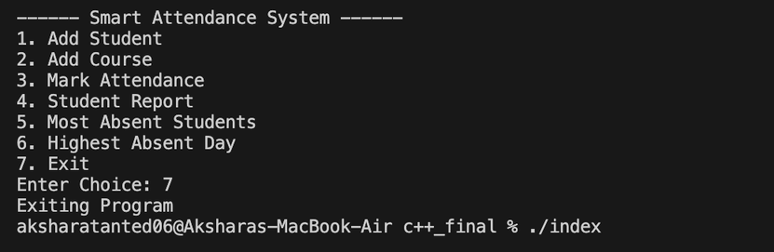
Workflow of system / Method
Start
↓
Load Student and Course Data
↓
Display Menu Options
↓
Add Student / Add Course
↓
Mark Attendance
↓
Store Attendance Records
↓
Generate Reports
↓
Check Defaulter Students
↓
End

Slide 5
Conclusion
Project Outcome
Successfully developed a Smart Attendance System using C++.
The project demonstrates:
Object Oriented Programming
File Handling
Menu Driven Programs
Data Analysis using attendance records
Benefits:
Reduces manual work
Improves accuracy
Helps identify defaulter students quickly
Provides structured attendance management

Slide 6
Thank You

